Slide 1
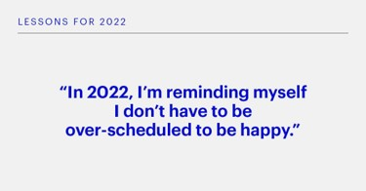
Platform: LinkedIn
Country: US
Account: Brian Levitt
Country: Retail
Copy:
Are we approaching the end of a cycle or just navigating through a difficult period? Skip ahead to Global Market Strategist Brian Levitt’s interview with Romaine Bostick, Caroline Hyde, and Taylor Riggs at the 1:19:42 mark to hear his explanation for why he expects inflationary pressures to moderate over the next year.
Link: https://inves.co/3HXoVO8
Creative Asset:

Slide 2
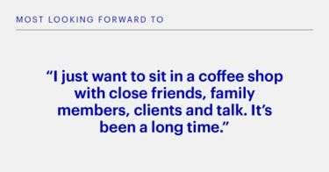
Platform: LinkedIn
Country: US
Account: Brian Levitt
Country: Retail
Copy:
Are we approaching the end of a cycle or just navigating through a difficult period? Skip ahead to Global Market Strategist Brian Levitt’s interview with Romaine Bostick, Caroline Hyde, and Taylor Riggs at the 1:19:42 mark to hear his explanation for why he expects inflationary pressures to moderate over the next year.
Link: https://inves.co/3HXoVO8
Creative Asset:

